Slide 1




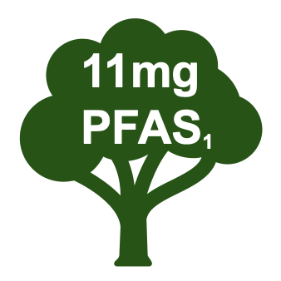
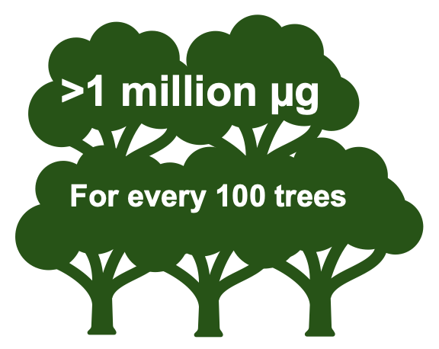
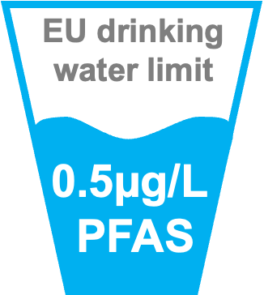

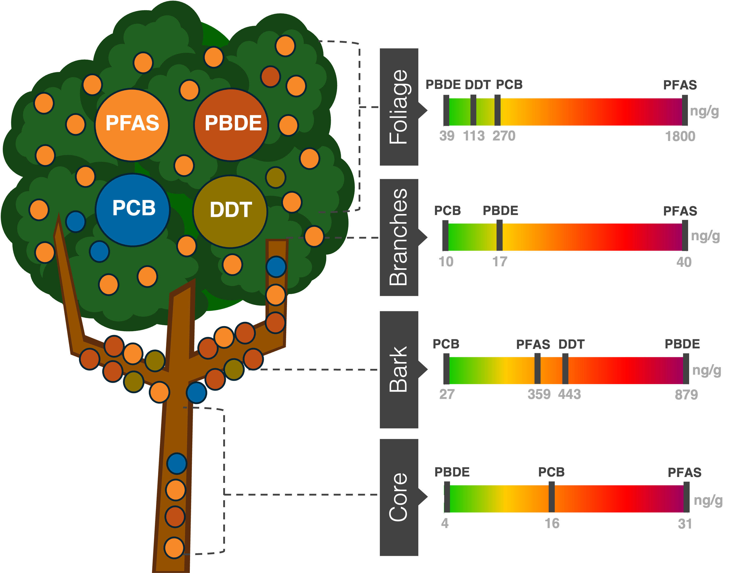
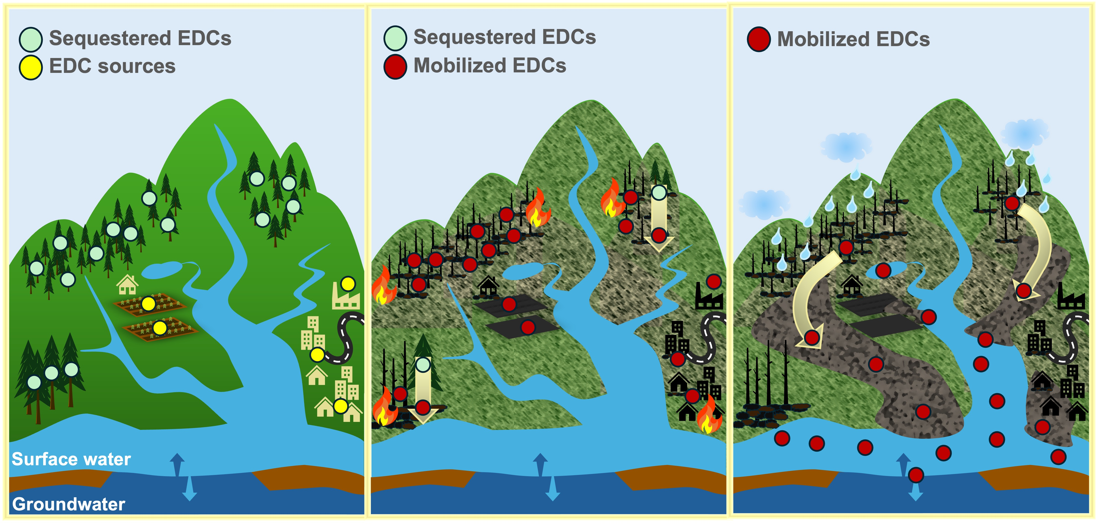
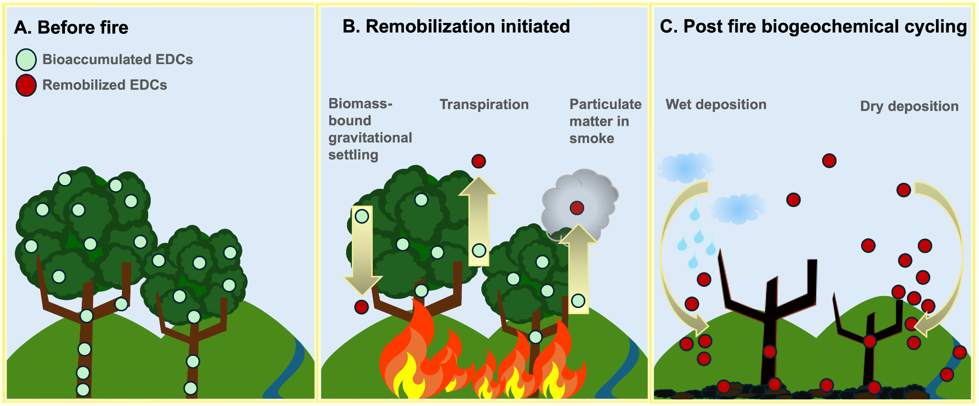

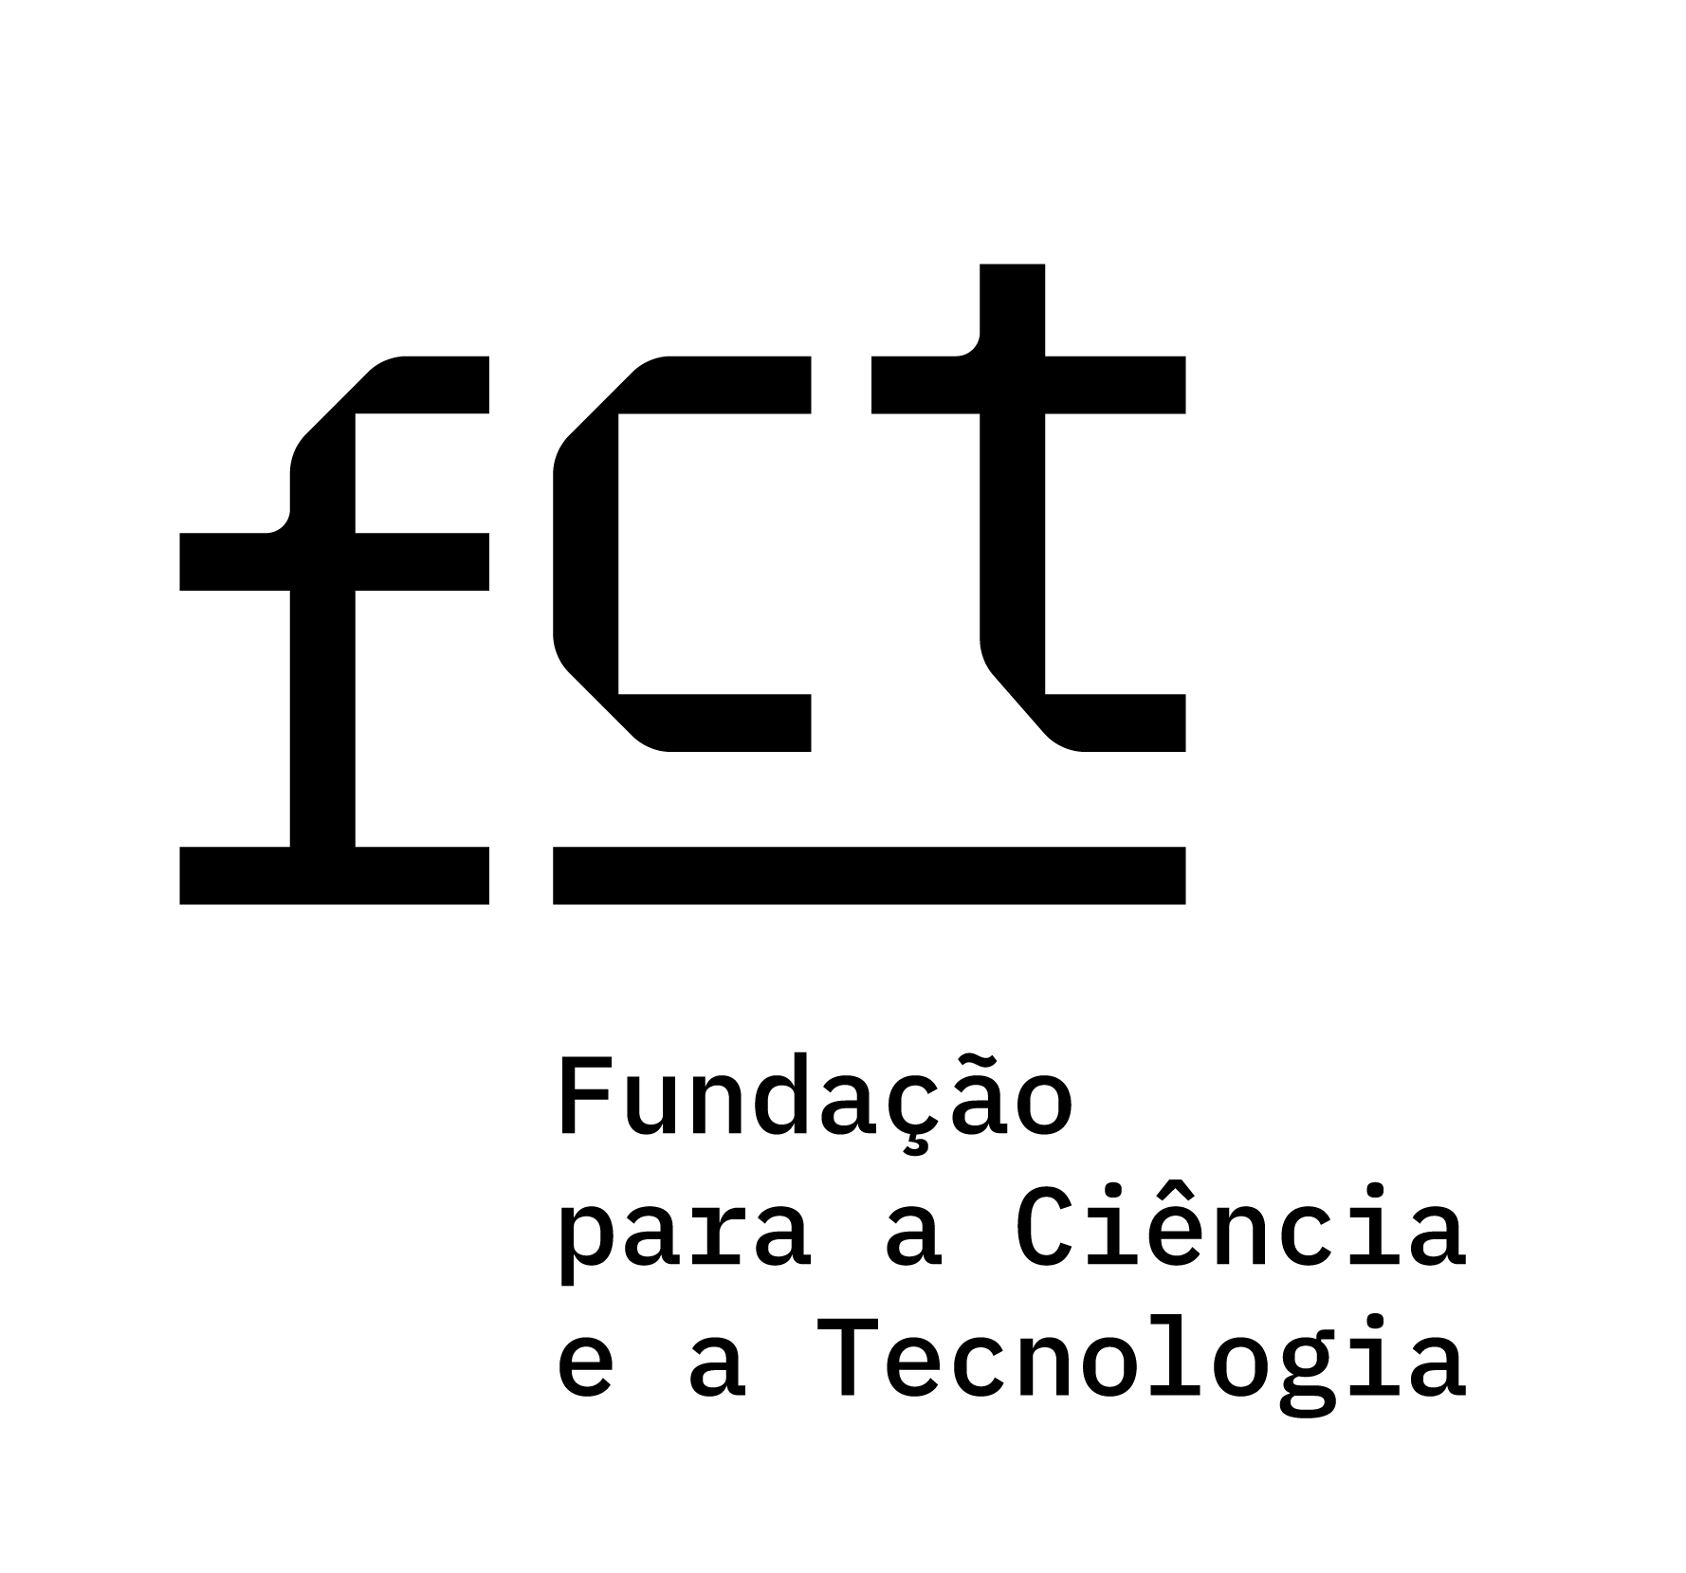
Reproductive Toxin Release In Watersheds Triggered by Wildfire
ENVIRONMENTAL ENGINEERING
HANNAH ELIZABETH SPENCER FITZHUGH hannah.fitzhugh@tecnico.ulisboa.pt
^{ABSTRACT}
CASE STUDY | PFAS PUBLIC HEALTH THREAT
A research group investigating phytoremediation of 26 PFAS substances in silver birch trees calculated total PFAS tree burden up to 11 mg/tree¹. Applying this finding in a forest scenario, for every 100 birch trees, there is potential that over 1 million µg of PFAS are sequestered. When those trees burn, what is the fate of the PFAS?
In 2029, we will reach a century of producing millions of tons of persistent endocrine disrupting chemicals (EDCs) into the geosphere, that remain and bioaccumulate.
Wildfire frequency now exceeds historical norms, signaling a shift into a new fire regime. This intensification threatens to alter ecosystem dynamics, posing risks to public health and biodiversity via widespread release of toxins.
Forests function as a sink, absorbing and encapsulating persistent EDCs through the surface area of all tree parts interfacing with the air, soil, and water (Figures 1,2).
OBJECTIVE: Assess the spaciotemporal magnitude of wildfire impact on transport of EDCs into estuary systems
PROPOSED MECHANISMS OF CONTAMINATION
During combustion of contaminated biomass, the heat-resistant EDCs may remain stable and release into the atmosphere, land, or water via multiple mechanisms (Figure 2). Wildfire erosion transports contaminants from fire-affected areas downstream into drainage basins, compounding harm to aquatic ecosystems and species². Wildfires likely disrupt the retaining and emitting zones, playing a critical role in the mobility and fate of EDCs within watershed systems (Figure 3).
Figure 1: EDC Contamination Profile per Tree Part
Summary of literature review findings representing the maximum reported concentration of toxin by tree part: polybrominated diphenyl ethers (PBDE), per- and perfluoroalkyl substances (PFAS), polychlorinated biphenyls (PBCs), and Dichlorodiphenyltrichloroethane (DDT).
Figure 3: Mobility and fate of EDCs within watershed systems impacted by wildfire
(A) EDC retaining and emitting zones with vegetation and soil as sinks and agriculture, industry, and urban zones as sources. (B) Wildfire destruction of EDC zones, initiating the remobilization of heat-resistant EDCs. (C) Runoff into aquatic systems, polluting surface and groundwater.
^{INITIAL FINDINGS}
Scoping review : Of 164 studies screened only 11 addressed how wildfires influence the transport of the select chemical group: 8 studies of the air matrix, 4 of soil, 2 of biota, and 0 investigated transport within the aquatic matrix.
EDC Contamination Profile in tree: 277 studies screened to analyze concentration of EDCs by tree part, revealing EDC contamination in all parts of the tree above ground (Figure 1).
Figure 2: Potential wildfire-induced release of EDCs from vegetation
(A) EDCs sequestered by plant (B) pyrolysis of plant biomass, EDCs remobilized via transpiration, gravitational settling bound to biomass, and smoke emissions bound to particulate matter (C) EDCs transported into the atmosphere, burnt debris, soil, or water and undergo biogeochemical cycling.
^{REFERENCES}
Gobelius, L., Lewis, J., Ahrens, L., 2017. Plant Uptake of Per- and Polyfluoroalkyl Substances at a Contaminated Fire Training Facility to Evaluate the Phytoremediation Potential of Various Plant Species. Environ. Sci. Technol. 51, 12602–12610.
Paul, M.J., LeDuc, S.D., Lassiter, M.G., Moorhead, L.C., Noyes, P.D., Leibowitz, S.G., 2022. Wildfire Induces Changes in Receiving Waters: A Review With Considerations for Water Quality Management. Water Resources Research 58, e2021WR030699.
Marcos Duarte Mateus
Environmental Engineering
Supported by FCT/MCTES (PIDDAC) through projects UIDB/50009/2025, UIDP/50009/2025 and LA/P/0083/2020

