Slide 1
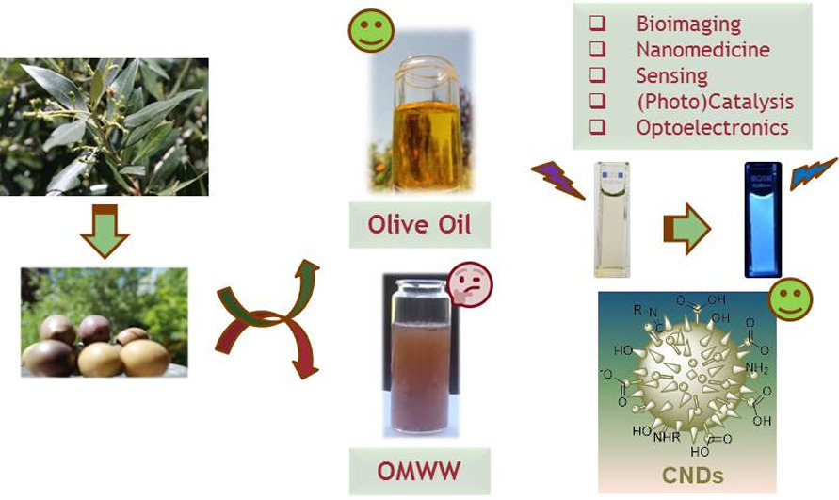
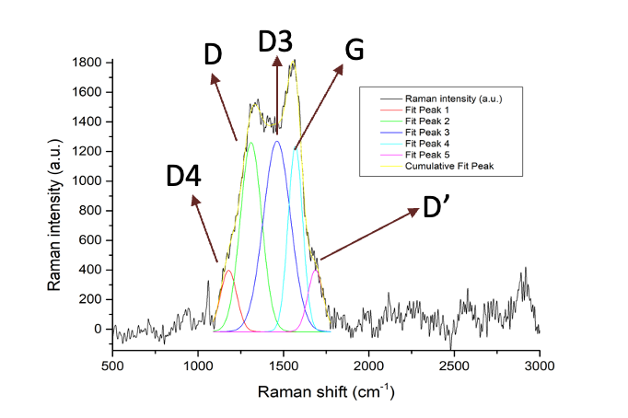
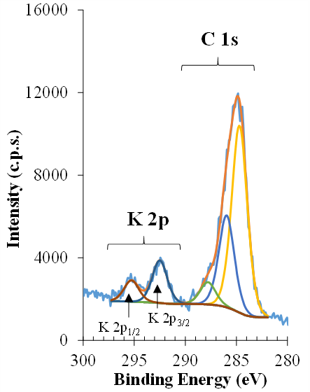
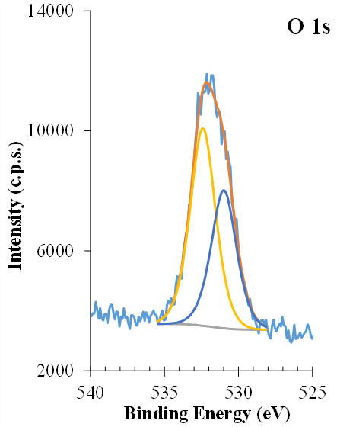
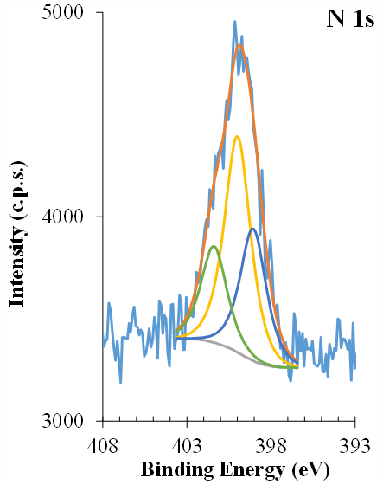
Carbon nanomaterials from industrial biomass wastes
Chemistry
Diogo Alexandre Cartaxo Sousa (diogo.cartaxo@tecnico.ulisboa.pt)
FRAMEWORK
Morphology and Structure
Two-phase extraction systems of olive oil result in a by-product (wet pomace), which reaches around 800 kg/ton of processed olives. Its chemical composition includes polysaccharides, proteins and polyphenols, making it a promising renewable source for the synthesis of luminescent carbon dots (CDs). Olive mill wastewaters (OMWW) from the same industrial process have already been used for CDs production¹.
Raman
FTIR
XPS
Partial Phd GOALS
Use wet pomace for CDs production using sustainable and practical synthetic methodologies.
Study of the CDs’ structure-optical properties relationships and the origin of their luminescence.
Synthesis
The CDs synthesis is based on a hydrothermal carbonization (HTC) at moderate temperatures.
Remarks and conclusions
CDs were produced in considerable chemical yields from wet pomace following HTC procedures.
Luminescent properties of the as-synthesized CDs were evaluated by steady-state and time-resolved fluorescence spectroscopy; QYs ranging from 0.06 to 0.23.
The CDs structural and morphological features were obtained from FTIR, Raman, XPS and TEM analysis; from TEM, particles sizes were found between 1.5-3.5 nm.
The as-synthesized CDs show significant anisotropy (not shown). Time-resolved experiments have indicated rotational correlation times between 0.24 ns (water) and 16.5 ns (glycerol).
Collisional quenching of CDs fluorescence by heavy atoms (NaI) yielded a bimolecular quenching constant approaching the diffusional limit (~ 5.6 x 10⁹ M⁻¹ s⁻¹), indicating free availability of emitters to the quenchers.
Immediate future work will involve purification of CDs through gel-permeation chromatography or other size fractioning methods.
Photophysical properties
References: ¹Sousa D. A., Costa A. I., Alexandre M. R., Prata J. V., Sci. Total Environ., 2019, 647, 1097.
Acknowledgments: The financial support from FCT through projects UIDB/00616/2021, UIDP/00616/2021, UIDB/04565/2020, UIDP/04565/2020 and i4HB project LA/P/0140/2020 is highly appreciated. I am also grateful to FCT for the doctoral grant SFRH/BD/143369/2019. Acknowledgements are also due to Profs. Ana Rego, Ana Ferraria, Luís Filipe V. Ferreira and Dr. Alexander Fedorov for their work with XPS, Raman, and TRF techniques.
Professor José Virgílio de Sousa Coelho Prata
Professor Mário Nuno Berberan e Santos
Chemistry

