Slide 1
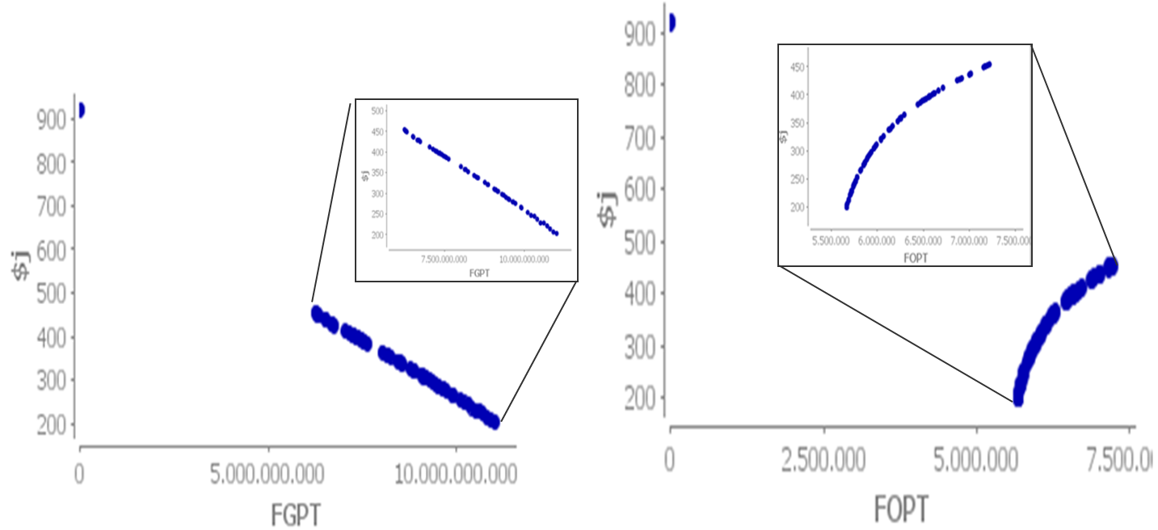
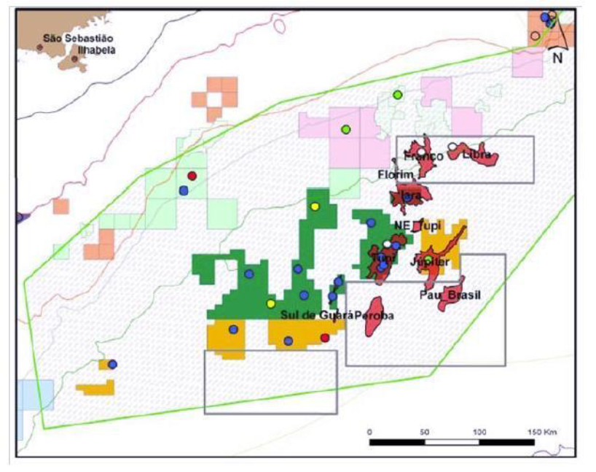
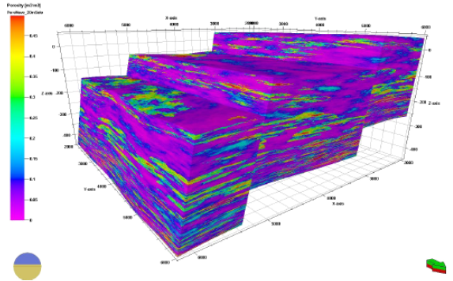
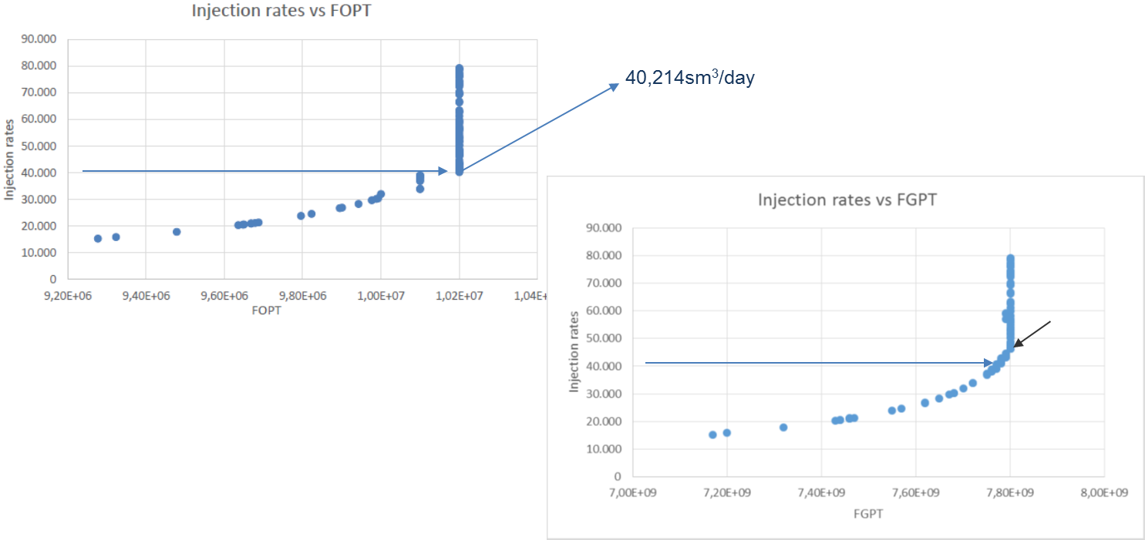
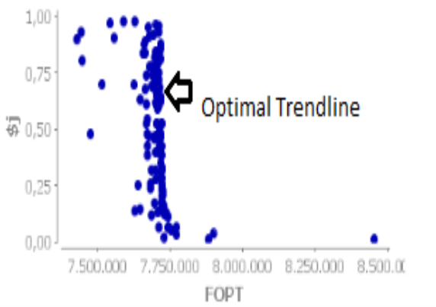
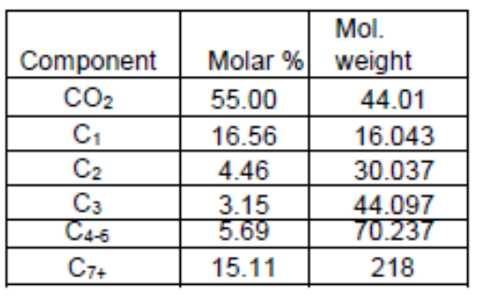
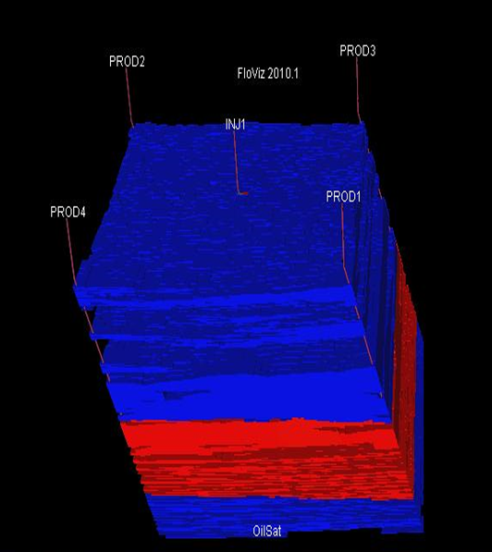
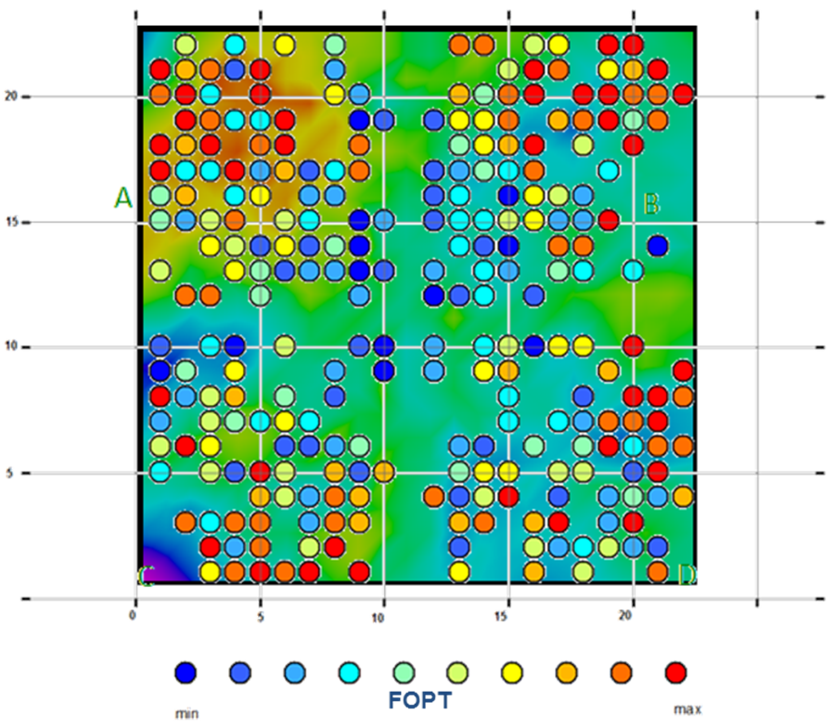
Optimization of A Water Alternating Gas Injection Scheme: A case study on a Brazilian Pre-Salt Field
PHD PROGRAMME IN PETROLEUM ENGINERING
FABUSUYI JOHN (fabusuyi.john@tecnico.ulisboa.pt)
^{CERENA-I}
^{Dataset Description}
This study is a continued interest in the CERENA-I reservoir (Pedro Pinto, 2014) from the Brazilian Pre-Salt play, with a very high content of CO2. This Brazilian Pre-salt reservoir poses great challenges in every aspect of its production, from reservoir modelling and management, to surface facilities. The reservoir covers an area of 567 km2 about 300km offshore of Rio de Janeiro, in the Santos basin. It is situated in water depths of around 2000m, with the top of the reservoir situated at approximately 5200m. It has a 90m thick heavy oil leg with 18o API and 55% (molar) of CO2 content. It also has a gas cap of retrograde condensation gas which contains approximately 60% (molar) of CO2.
^{Results}
^{1) Optimization of Engineering} ^{Parameters}
^{Injection rate and WAG Ratio}
^{Bottom-hole Pressure}
The Brazilian Pre-Salt Play (Source: ANP) and the CERENA-1 porosity model
The model is composed of two facies: a reservoir facies, composed by microbiolites; and a non-reservoir facies composed by mudstones, on a corner-point grid with 161x161x300 cells, with 25x25x1m spacing. Permeability was modelled recurring to the porosity model and it exhibits a dependence that was derived from real analogues. Due to the lack of real data from analogue fields the oil composition for this study was obtained from a generic sample of oil from Petrel's® library, grouped to reduce computation time and memory requirements, and with the molar percentages re-adjusted to the known CO2 content of the analogue field (Table 1).
^{2) Well Positions}
Molar percentages of the oil with grouped components and Estimated saturation pressures
The production strategy selected for producing this reservoir was a Simultaneous Water Alternating Gas Injection scheme. Four producing wells and a single injection well was implemented. The injection well injects both water and gas at the same time. The main objective function was to maximize the total oil produced and simultaneously minimizing gas production. Engineering parameters and well positions were optimized.
^{Conclusion}
The dynamic simulation and optimization of the production scheme for this reservoir shows the inter-relationship between the bottom-hole pressure and the oil and gas production. The Optimum BHP was at about 454 bars for the 4 wells, while the optimum injection rate was about 40,214 sm3/day for any WAG ratio along the optimal trendline.
^{Further Work}
The next step for this research is to develop another EOR method that could help reduce the CO2 production especially using with the Chemical EOR techniques.
Initial and new production strategy for producing the reservoir.
Supervisor: Maria João Pereira and Maria Joao Quintao
PhD Program: Petroleum Engineering

