Slide 1
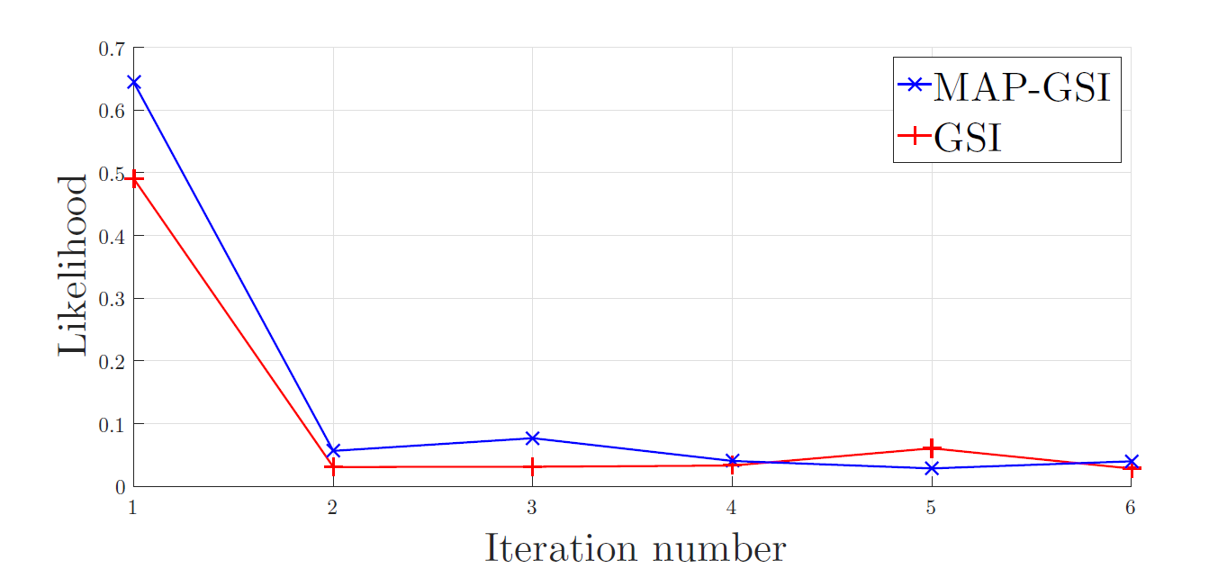
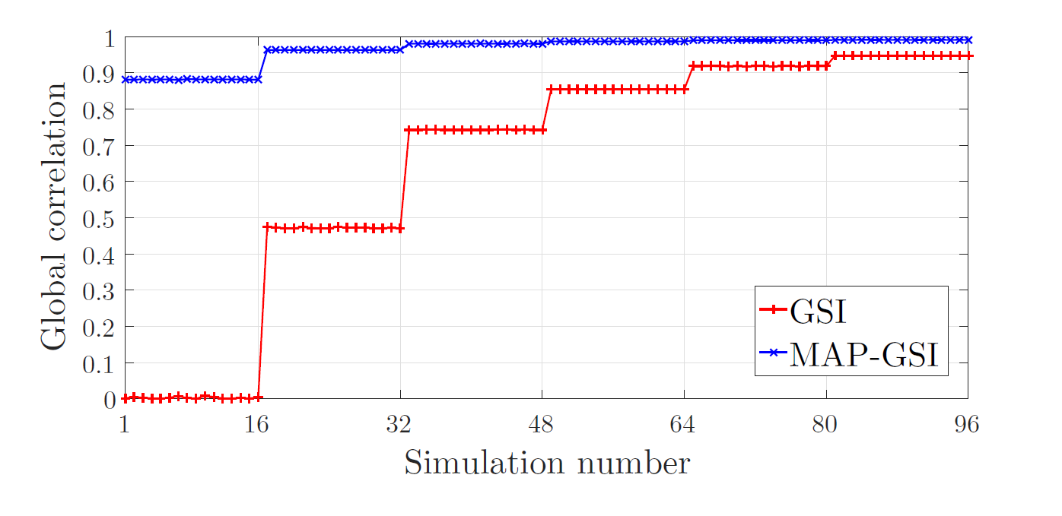
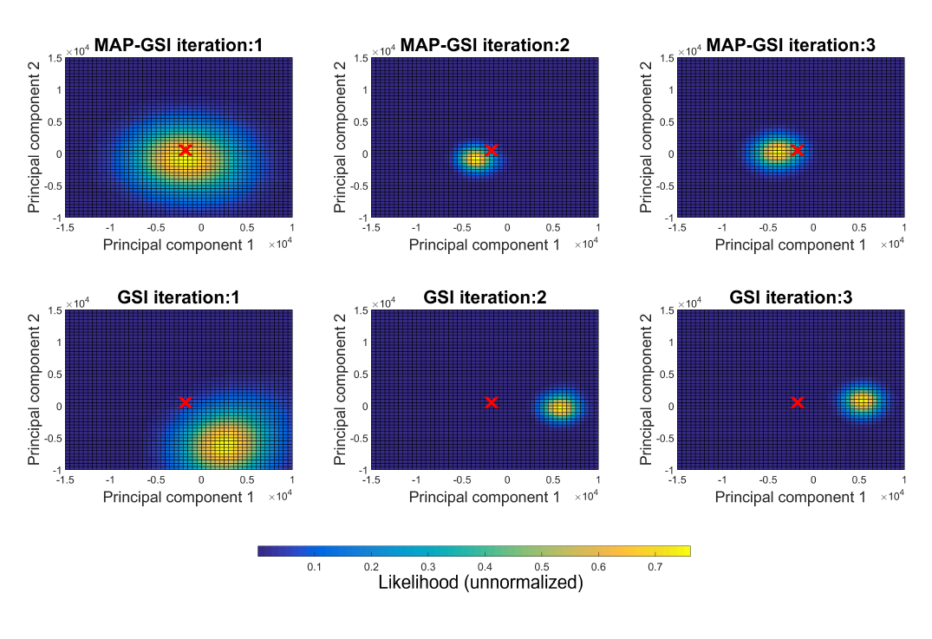
Hybrid Bayesian Linearized Acoustic Inversion Methodology
PhD in Petroleum Engineering
Fernando Bordignon (bordi@inf.ufsc.br)
^{Introduction}
Seismic inversion is an important technique for reservoir modeling and characterization due to its potential in inferring the spatial distribution of the subsurface elastic properties of interest. Two of the most common seismic inversion methodologies within the oil and gas industry are iterative geostatistical seismic inversion (GSI) and Bayesian linearized seismic inversion (BLI). Though the first technique is able to explore the uncertainty space related with the inverse solution in a more comprehensive way, it is also very computationally expensive when compared against the Bayesian linearized approach.
In this work it is proposed a novel hybrid seismic inversion procedure that takes advantage of both frameworks: an iterative geostatistical seismic inversion methodology is started from an initial guess model provided by a Bayesian inversion solution. We also propose a new approach to model the uncertainty of the retrieved inverse solution by means of Kernel Density Estimation (KDE) at a lower dimension reduced via Principal Component Analysis (PCA). The results show the robustness of the hybrid inverse methodology and the usefulness of modelling the uncertainty of the retrieved inverse solution.
FIGURE 2: Likelihood of the ensemble to sample the well log computed at 10D
FIGURE 3: Match between the synthetic and original seismic represented via global correlation
^{Results}
The results of experiments in synthetic data show that the samples generated by the proposed method (MAP-GSI) have a higher chance of sampling the reality while having a high match to the observed seismic data. Figure 1 shows a map of the chance of sampling, the yellow areas represent the higher likelihood areas, where the model space is being sampled more. It is clear that MAP-GSI is sampling models near the well log. Figure 2 and Figure 3 show that while at the first iteration GSI has a high likelihood, or chance to sample the reality, it has a low match between the observed data and the seismic of the generated samples, i.e. low global correlation level. Conversely the MAP-GSI at the first iteration has a high correlation level at the first iteration while also having a high chance of sampling the reality. Experiments considering other wells resulted in similar curves. Another experiment with real data yielded similar results.
^{Conclusion}
In cases where a MAP inversion result is acceptable as local means, the sampling of the posterior distribution is more efficient and the uncertainty modeling is more accurate when MAP-GSI is used as opposed to the GSI.
FIGURE 1: Low dimensional kernel estimation of the sampling at the well position, with the well represented as a red x
^{Methodology}
The new approach proposed on this work increases the efficiency of GSI by initializing it from a solution retrieved by the BLI solution for the inverse problem. The initialization provides a fast initial solution avoiding the execution of the search iterations performed by the original GSI, whereas the drawbacks of the linearized trace-by-trace inversion are overcome by providing spatial modeling via stochastic sequential simulation.
For the analysis of the results a dimensional reduction method, PCA, was applied to the samples at the same position of the well. Afterwards, the underlying density function was estimated with kernel density estimation for each iteration, giving rise to the images at the Figure 1. The well log, represented as a red x, is the target, and the goal is to sample around this target with the lowest variance possible.
Supervisor Prof. Amilcar Soares and Mauro Resembetg (UFSC)
PhD in Petroleum Engineering

