Slide 1
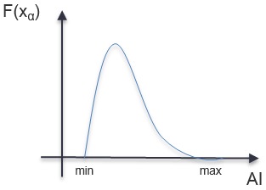
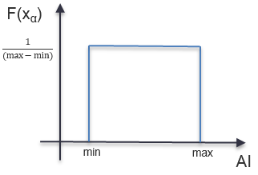
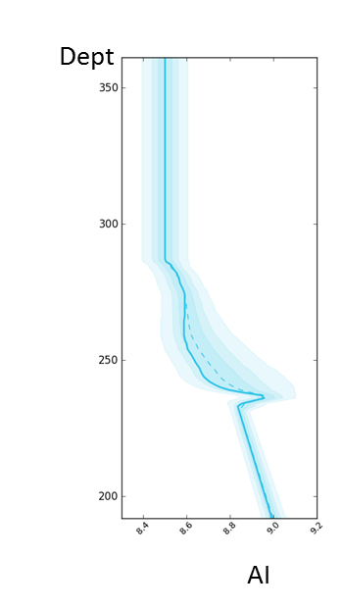
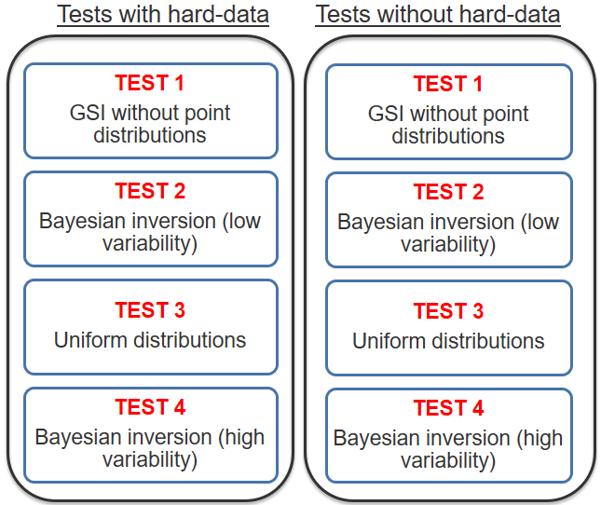
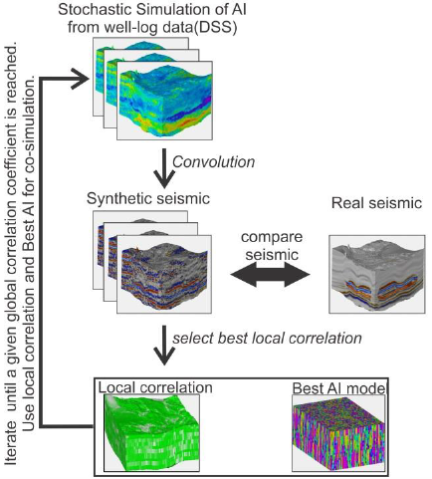
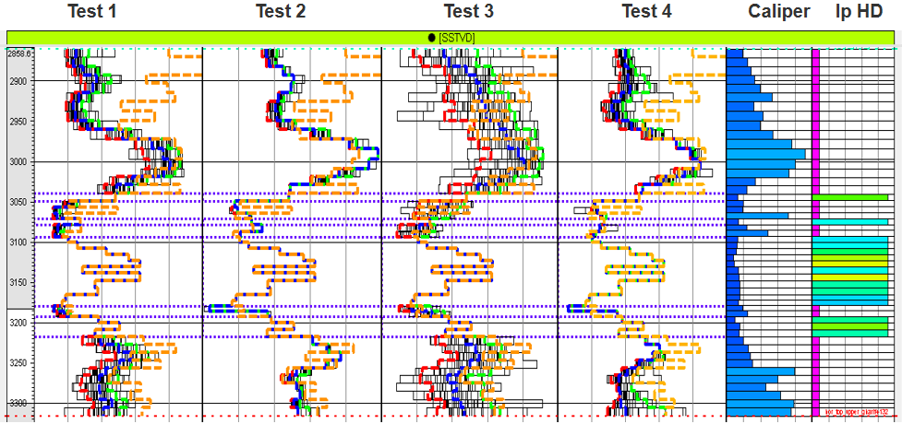
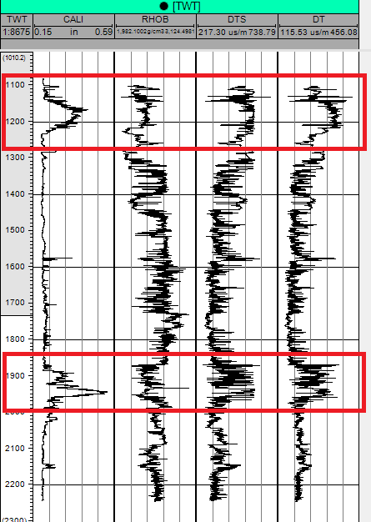
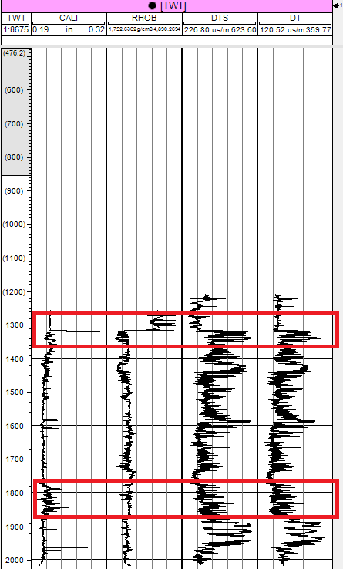
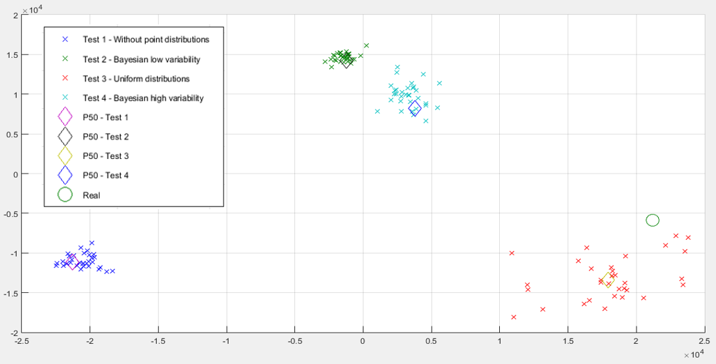
Integration of uncertain well data for seismic reservoir characterization
PHD IN PETROLEUM ENGINEERING
PEDRO PEREIRA (pedropereira17@gmail.com)
^{Motivation}
Traditionally, the well-log data is used as experimental data within geostatistical seismic inversion procedures and it is usually assumed as reliable measurements of the subsurface properties without associated uncertainty.
However, there are zones along the well path where collapses of the borehole wall may affect the readings of the petrophysical property of interest. These collapses can be caused, for example, due to a lithology variation. The available well-log data should not be considered experimental data without uncertainty. During well-logs analysis, it should be taking into account the petro-elastic logs along with caliper log (Figure 1), in order to verify if there are some variations that might correspond to collapse zones along the well path.
FIGURE 2: Methodology applying the simulation with point distributions (on the left) and the respective GSI tests performed in this work (on the right).
FIGURE 3: Comparison between the inverted logs from Ip models for all the tests: real Ip log (orange lines), 32 models from last iteration (black lines), P10 (red lines), P50 (blue lines) and P90 (green lines) scenarios. On the right hand side, there are the caliper log and the Ip log data used as hard-data. The purple color values correspond to the uncertain areas where the Ip experimental data were removed. based on the criteria that, along the caliper well path, the values that were bigger than 0,22 inch it would be removed on the corresponding Ip HD at the same location before integrate the conditioning of GSI. The presented results are from the GSI tests with hard-data for the well 4.
FIGURE 1: Uncertain zones of 2 wells, from the dataset applied, with respective logs (from left hand side to the right) of caliper, density, DT and DTS.
^{Methodology}
The new iterative geostatistical seismic inversion methodology is based on the Global Stochastic Inversion (GSI; Soares, 2007) and allows the integration of well-log data measurements affected by uncertainty within the inversion procedure, recurring to stochastic sequential simulation with point distributions (Figure 2).
^{Real Case Study}
The proposed methodology was applied and implemented in a real dataset comprising 6 wells, with Ip log data, a fullstack reflection seismic data and a wavelet extracted from the real fullstack volume. It was assess the performance of this inversion procedure applying several GSI tests (Figure 2).
In order to evaluate the uncertainty of the inverse solution it were computed, from the ensemble of Ip models generated during the last iteration of all the tests, the models corresponding the P10, P50 and P90 scenarios.
The convergence of the inversion procedure was compared by using the inverse models retrieved from the different tests from the last iteration of the inversion procedure at the wells locations along with the real Ip log (Figure 3). The multidimensional scaling (MDS) technique was used to project all the Ip logs in a metric space based on the Euclidean distances between the inverted and real logs (Figure 4).
FIGURE 4: Well-log data, from respective GSI tests without hard-data, represented into MDS space, attending all the 6 available wells, simultaneously.
^{Conclusions}
This new methodology allows the integration of uncertain experimental data and the estimation of the petro-elastic properties measured along the well path, show that the use of point distributions offers a better alternative for accounting for the collapsed sections uncertainty compared to removing those sections. The inclusion of uncertainty on the experimental data increases considerably the exploration of the model parameters space, reducing the uncertainty of the properties at the well-logs.
Supervisors: Amílcar Soares and Leonardo Azevedo
PhD in Petroleum Engineering

