Slide 1
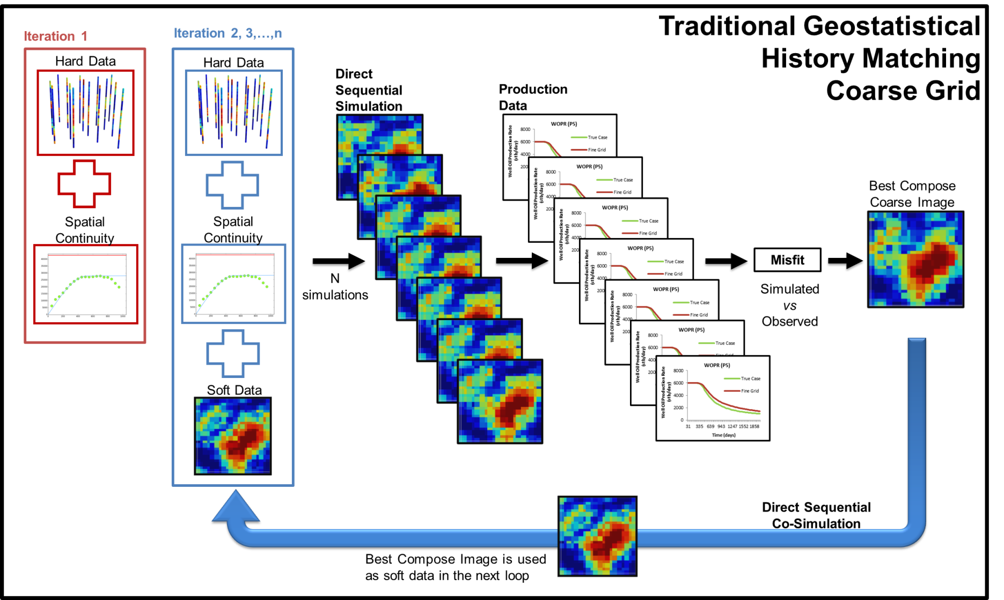
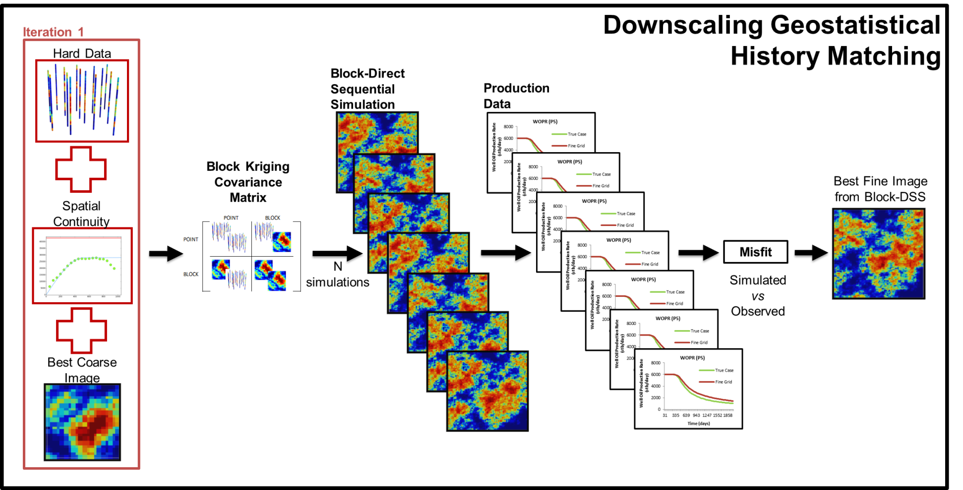
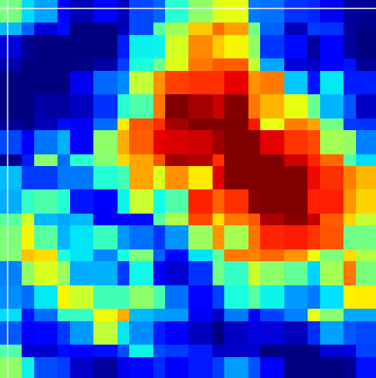
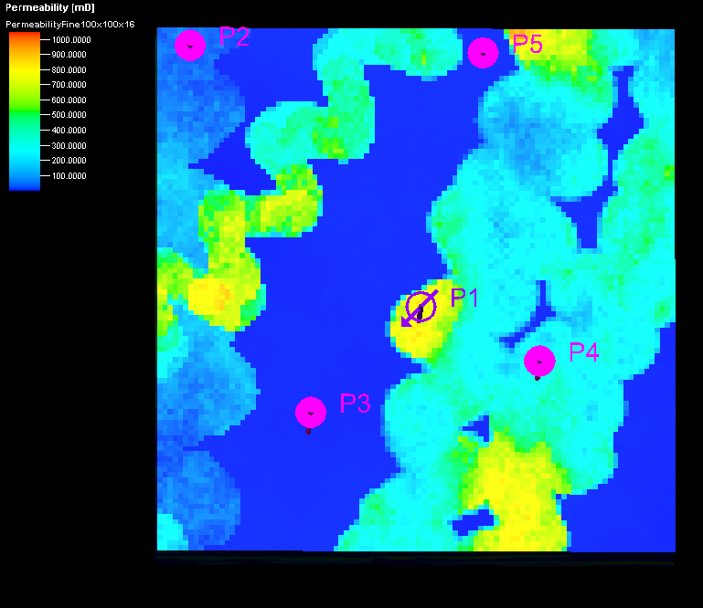
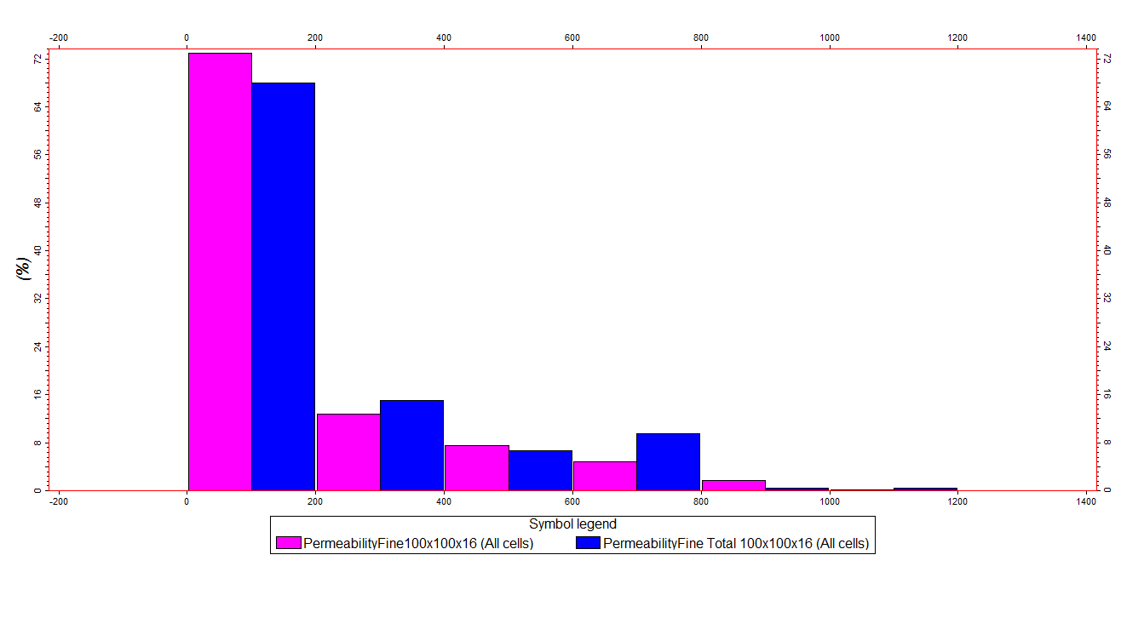
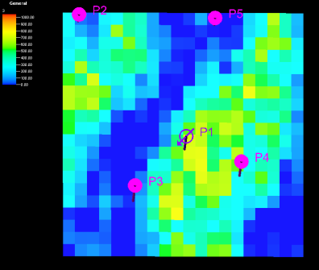
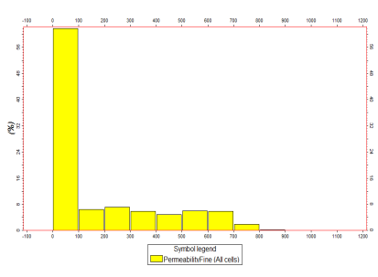
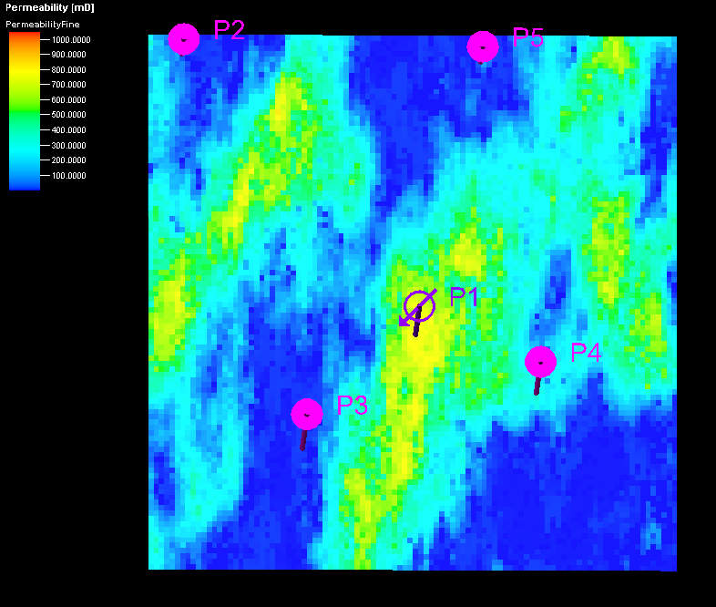
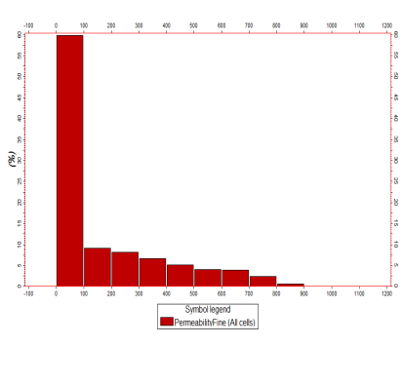
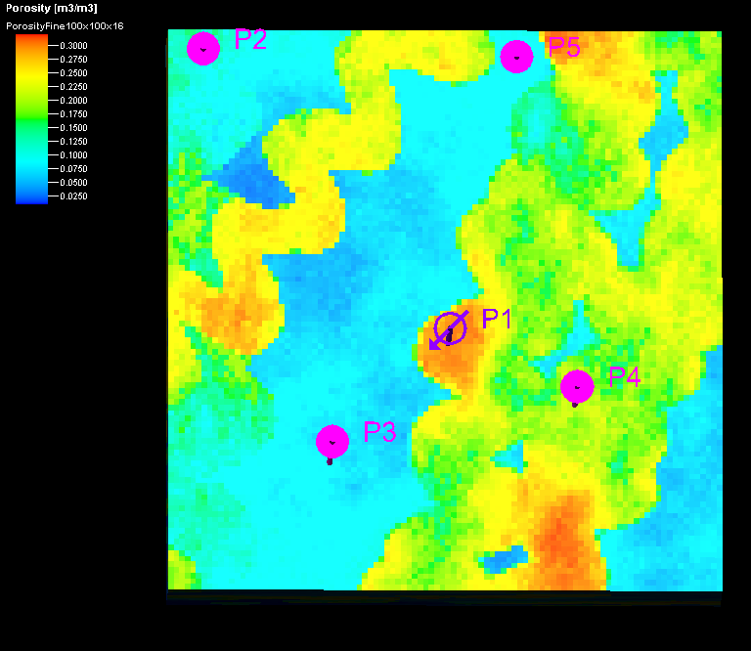
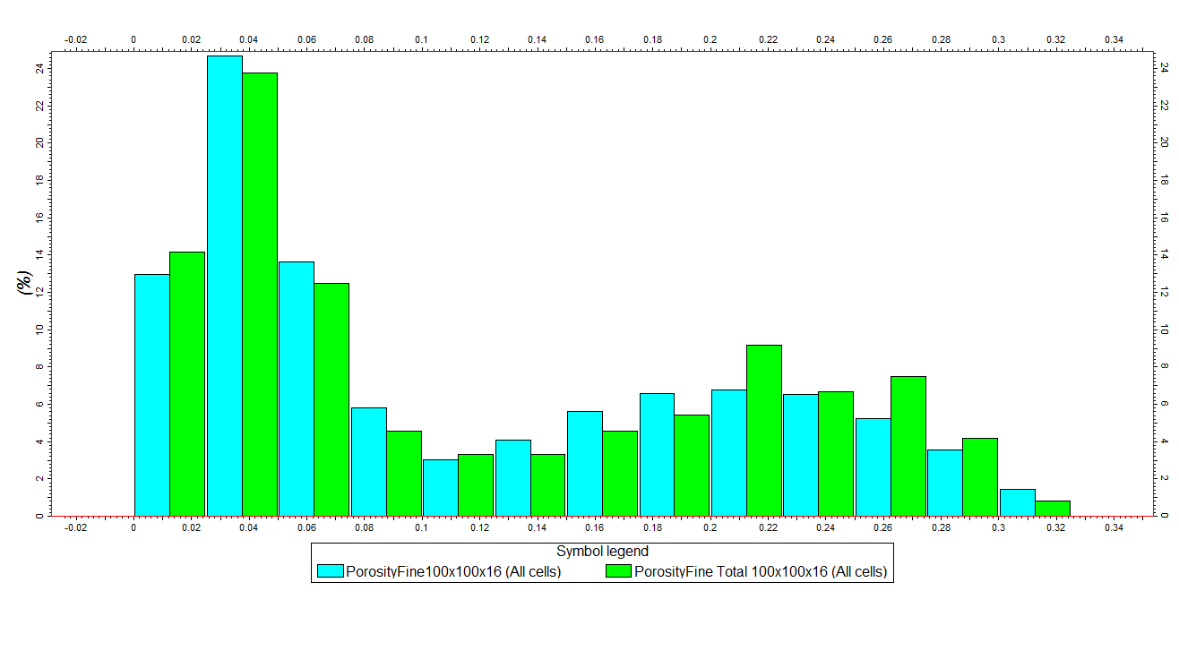
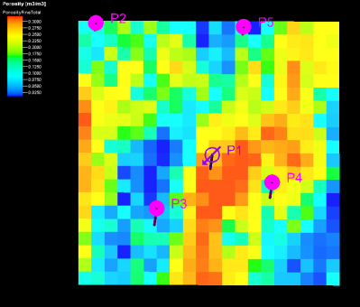
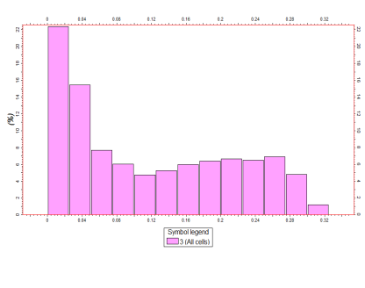
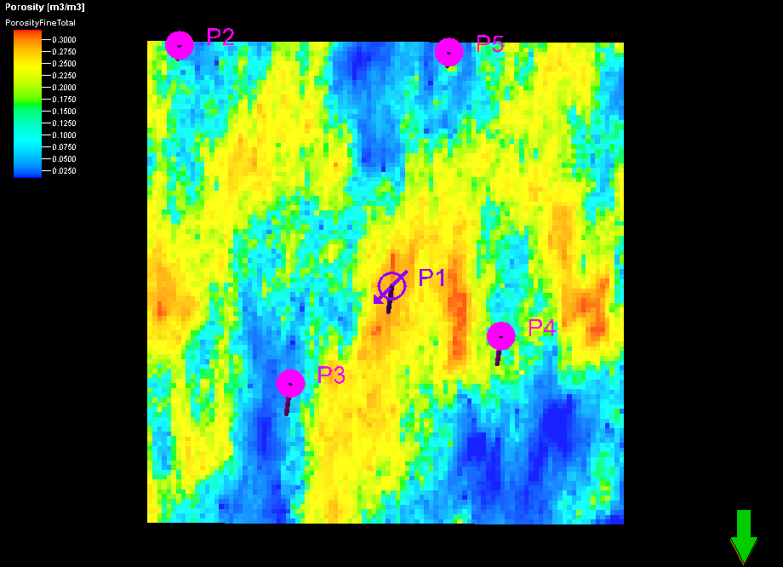
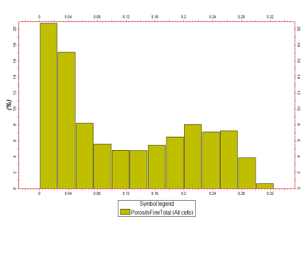
Geostatistical History Matching Methodology using Block-DSS for Multi-Scale Consistent Models
PHD PROGRAM IN PETROLUM ENGINEERING
CATARINA MARQUES (catarinarfmarques@tecnico.ulisboa.pt)
^{Challenge}
During the last decades, the challenges of modelling subsurface Earth’s properties generated a remarkable development of reservoir modelling techniques that allow incorporating different sources of available information such as, historical production data, seismic reflection data and well-log data. However, all this information is traditionally used individually to model the reservoir at different stages during the geo-modelling workflow. Integrate all the available data faster and with accuracy in a unique workflow is still one big challenge. To optimize and speed-up a reservoir modelling conditioned to well-log data and historical production data, we developed and implemented a new geostatistical history matching algorithm. The optimization loop is performed at multiple reservoir scales allowing a faster convergence without losing accuracy.
^{Methodology}
We introduce an iterative geostatistical history matching procedure able to generate geological models at diverse levels of detail. The multi-scale geostatistical history matching workflow integrates two history matching loops:
¹⁾ Traditional geostatistical history matching is performed at a coarse reservoir grid by iteratively perturbing it until a given misfit value between simulated and observed production data is achieved.
2) The best coarse grid model is refined using a block direct sequential simulation (Block-DSS) to downscale the matched coarse grid and improve the history matching with the assimilated course information, while propagating the uncertainty through the different scales.
^{Workflow}
Best Coarse Image
Block-DSS
^{Downscaling}
Combination of block simple kriging with DSS allows to incorporate information from two different scales: block data and point data.
^{Results}
^{True Reservoir Model}
^{Best Coarse Iteration}
^{Best Fine Iteration}
^{True Model (Permeability)}
Iteration 30 (Matched Permeability)
Block DSS (Matched Permeability)
Reference Model (Porosity)
Iteration 30 (Matched Porosity)
Block DSS (Matched Porosity)
^{Further Work}
In the previous workflow we integrated well-log data and historical production data, but how to integrate all the available data in a unique workflow? Frequently the petrophysical properties models retrieved by seismic inversion are used as input for history matching procedures. But the perturbation of the model parameters during history matching, as they are not conditioned to seismic, may generate models that no longer match the observed seismic.
With this work we proposed a novel methodology to integrate all available data - well-log, production data and seismic reflection data – coupling the objective of the two inverse problems into a single loop optimization. The proposed methodology aims to achieve one solution – petrophysical property models – which minimizes simultaneously the objective functions of both methods.
Supervisor: Amilcar Soares and Leonardo Azevedo
PhD Program in Petroleum Engineering

