Slide 1
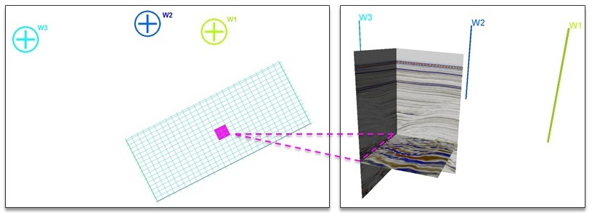
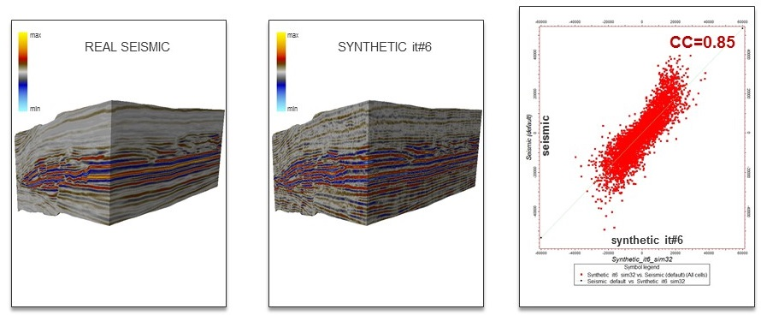
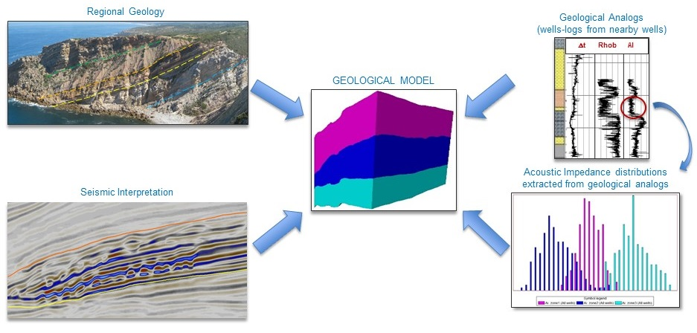
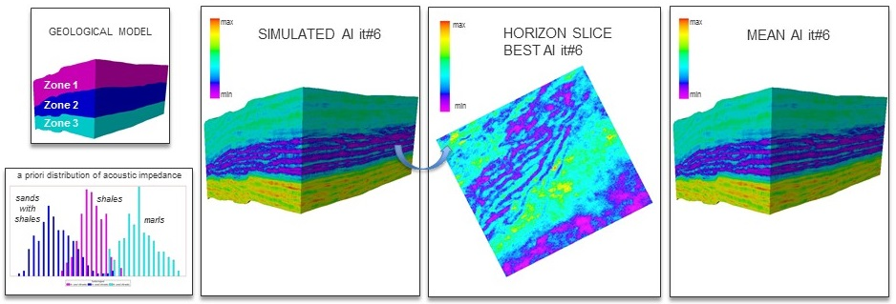
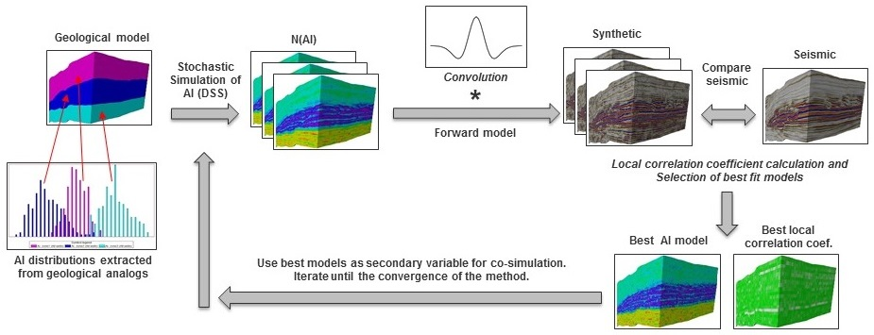
Earth models for early exploration stages
PETROLEUM ENGINEERING
ÂNGELA PEREIRA (angela.pereira@tecnico.ulisboa.pt)
Introduction
Frontier basins and unexplored areas are challenging new venture projects due to the high risk and uncertainty related to scarcity of the data. Geological knowledge of the basin and seismic data are the main support in the first stages of an exploration project. All the geological information, obtained from analogs (e.g. nearby well-log data) can be a very import information to characterize the subsurface geology of this unexplored area. Seismic inversion methodologies are commonly used to generate elastic subsurface models for reservoir characterization and uncertainty assessment, based on the seismic reflection data and well-log data available. The methodology presented in this work uses a geostatistical seismic inverse problem without the need for well data. In this work we present a new iterative geostatistical seismic inversion methodology based on the Global Stochastic Seismic Inversion algorithm (Soares et al 2007; Caetano, 2009) that uses geological analogs to get a priori acoustic impedance (AI) distributions that are used to estimate acoustic impedance models as the result of a seismic inversion process.
FIGURE 3: Case study area showing the seismic data and 3 appraisal wells outside the area that were used as geological analogs.
Results
The method converged at the end of 6 iterations (Figure 4) with a global correlation coefficient between real seismic and synthetic seismogram of 0.85 (Figure 4). The best fit model of acoustic impedance (Figure 5) respected the initial acoustic impedance distribution and the geological features (channels) were reproduced. In Figure 4 it is possible to see the differences in seismic amplitude between the real seismic and the synthetic seismogram.
Methodology
The proposed iterative Geostatistical Seismic Inversion algorithm uses geological analog information to solve the problem of lack of data typical of unexplored areas and early stages of exploration. First it is defined a geological model (Figure 1) of the study area with different lithofacies regions, for example by integrating seismic interpretation. After this, it is integrated in this model different a priori acoustic impedance (AI) distributions obtained from geological analogs (e.g. nearby wells) that have a geological correlation with the study area, where each distribution corresponds to the expected lithofacies for each geological region. After this the method can be summarize in the following steps (Figure 2):
FIGURE 4: Correlation between real seismic and synthetic seismogram.
FIGURE 1: Geological model integrating the information from the main seismo-stratigraphic units and the a priori acoustic impedance distributions extracted from the geological analog.
FIGURE 5: Acoustic impedance models obtained from the seismic inversion
Conclusions
This new seismic inversion methodology, integrating seismic data with geological analogs prove to be valuable tool to be applied on early exploration stages or on unexplored areas, were normally well-log data is absent or sparse. By integrating the information from geological analogs, it is possible to predict more reliable subsurface geological models, for prospect characterization and uncertainty assessment.
Acknowledgements
The authors would like to thank Partex Oil & Gas, Schlumberger and CCG.
References
Caetano, H. [2009] Integration of Seismic Information in Reservoir Models: Global Stochastic Inversion, PhD thesis, Instituto Superior Técnico, University of Lisbon.
Pereira A., Nunes R., Azevedo L., Guerreiro L. & Soares A. [2016] Seismic inversion using analogs for reservoir characterization and uncertainty assessment in early stages of exploration. Search and Discovery, Proccedings of International Conference and Exhibition AAPG/SEG 2016 (Accepted).
Pereira A., Nunes R., Azevedo L., Guerreiro L. & Pereira M.J. [2015] Global Stochastic Inversion Using "Analogs-wells" and Zonal Distributions - Application to an Unexplored Area. Proceedings of EAGE 2015 Conference - Petroleum Geostatistics.
Soares, A., Diet, J.D. & Guerreiro, L. [2007] Stochastic Inversion with a Global Perturbation Method, EAGE Conference on Petroleum Geostatistics, Extended Abstracts.
FIGURA 2: Method workflow
Case study
The methodology proposed was applied to an unexplored area, where the potential reservoir is expected to be in a turbidite system (Figure 3). The only data available were a 3D seismic post-stack volume and 3 appraisal wells outside the area, with sonic and density logs. From these two we computed the acoustic impedance log. These appraisal wells were used as geological analogs. After the creation of the geological model with the main seismo-stratigraphic units defining the different lithofacies regions, was established the correlation to the geological analogs wells and then were extracted directly from the well-logs the a priori acoustic impedance distributions correspondent to each lithofacies. The wavelet used was a statistical wavelet extracted from the seismic. The seismic inversion process was run with 6 iteration each one with 32 realizations of acoustic impedance models.
Supervisor: Amilcar Soares and Leonardo Azevedo
PhD Program: Petroleum Engineering

